Slide 1
Battle of the Neighbourhoods Nairobi’s Neighbourhoods
By Rushab Shah

Slide 2
Background
Kenya, often dubbed the gateway to East Africa, is one of the fastest developing nations in Africa.
In recent years, Nairobi (the capital city of Kenya) has seen an influx of international immigration.
The growing expatriate community means that there is an increase in demand for accommodation. As Nairobi is still a developing country, information sources about the availability of facilities are limited in number and reliability.
This project is therefore, aiming to create a guide for expatriates that are either visiting or looking to move to Nairobi.

Slide 3
Problem Statement
The primary objective of this project is to provide a range of options, based on personal preferences, for the ideal neighbourhood to live when in Nairobi.
The project will take into consideration the diversity in demographic of the visitors to Nairobi and try to provide suitable options for each demographic.
It will achieve this by identifying 100 places within 500 metres of each Neighbourhood in Nairobi and, categorizing and grouping them, to indicate what services and facilities are nearby.

Slide 4
Data Acquisition
Three data sources will be used for this project:
Wikipedia Data Table: The table featuring Nairobi's constituencies and their wards is present on https://en.wikipedia.org/wiki/Nairobi_County. However, this table will need to be cleaned and processed so that it becomes a dataframe with a list of wards and each of their respective constituencies.
Geocoder Python Package: The Wikipedia data table featuring the list of constituencies and wards does not have any location data available. No other source for this data was found so the Geocoder python package will have to be used to find the latitude and longitude for each ward.
Foursquare API: The foursquare API will also be used to get data about the venues near each ward. We will look at 100 of the venues that are within 500 metres of each of the respective wards. This data will then be processed to understand the frequency of each of the categories.

Slide 5
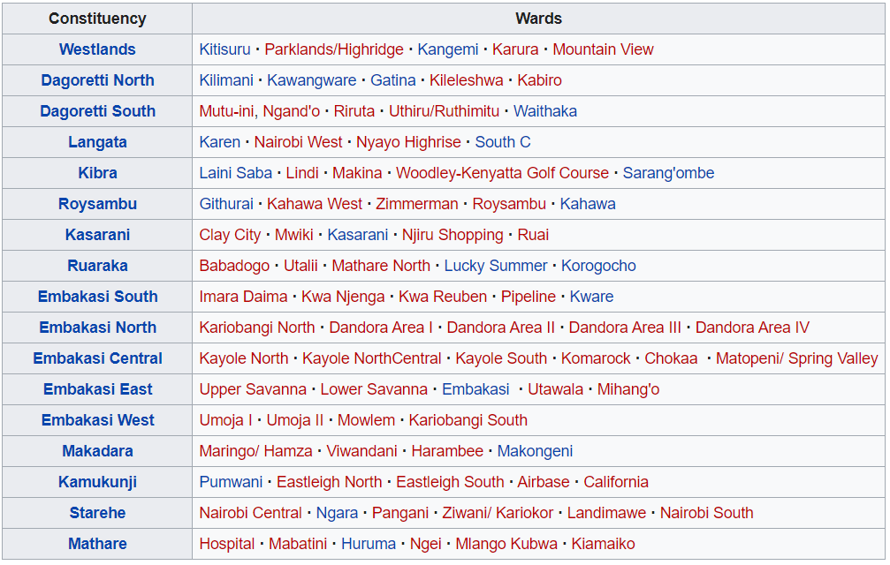
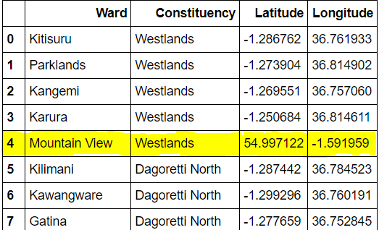
Data Cleaning and Transformation
Wikipedia data table was transformed into a list of ward and constituencies with their latitudes and longitudes.

Slide 6
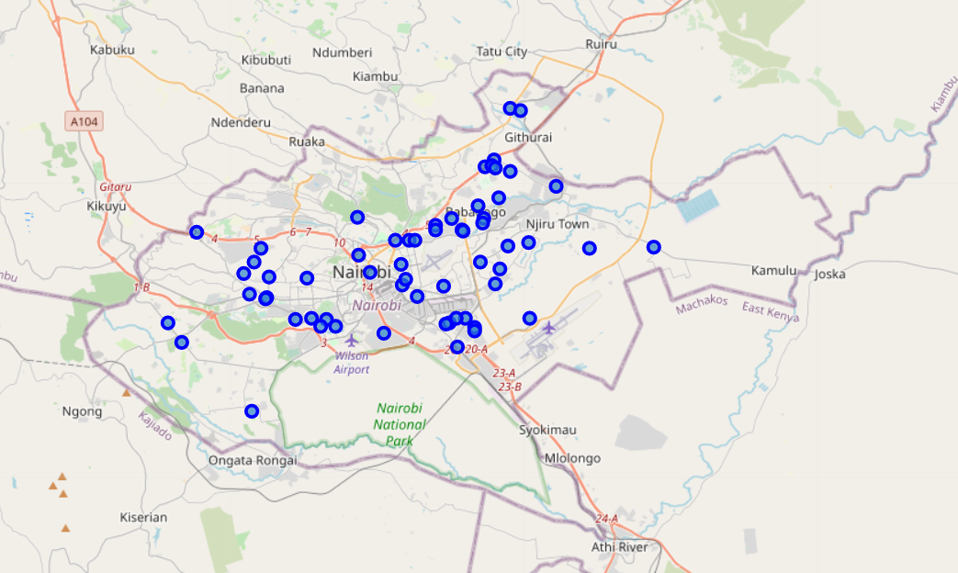
Preliminary Folium Visualization
A Folium visualization was created using the ward datapoints, showing the distribution of wards (neighbourhoods) in Nairobi.

Slide 7
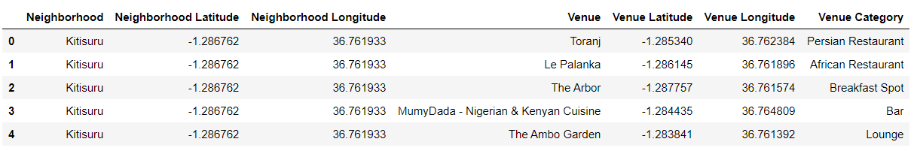
Foursquare API
The Foursquare API was used to acquire data for 100 venues and the categories of these venues, that were within a 500 metre radius of each datapoint.

Slide 8
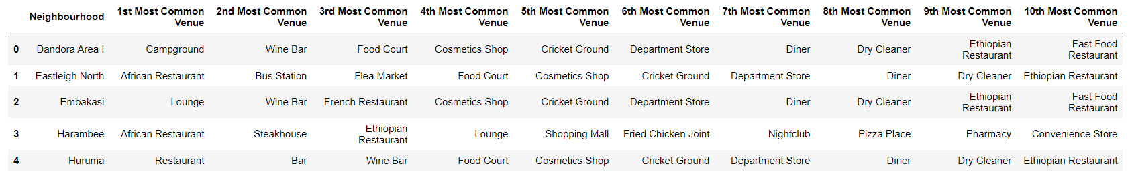
10 Most Common Venues
One hot coding was applied to the venue category and then the data was grouped by Neighborhood (Wards are now called Neighborhoods) to form another table showing the 10 most common venues for each location.

Slide 9
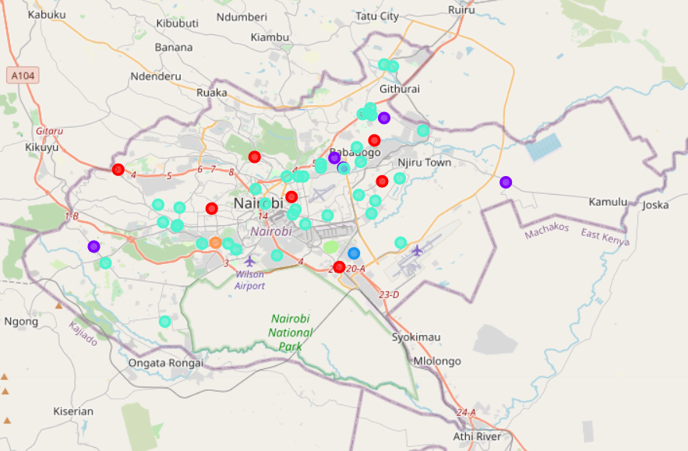
K Means Clustering
K Means Clustering was then applied to group the Neighbourhoods into several clusters. Different values of K were tested, with 6 clusters being identified as the best value for K. The map shows the results of the clustering.

Slide 10
Discussion
The best value for K in the K means clustering algorithm was found to be 6 as it delivered the most even spread of clusters.
The 6 clusters formed are of varying lengths with Cluster 3 being the largest with 37 Neighborhoods and, Cluster 2 and 5 the smallest with just 1 neighbourhood.
Not all the datapoints were used, as the location data (latitude and longitude) could not be found for all the datapoints, however, the data points used represented most neighbourhoods in the city of Nairobi.
The venues present in Cluster 3 display a wide range of facilities and services that potential expatriates may be interested in. This indicates that this cluster probably features the best neighbourhoods to stay in for those visiting Nairobi.

Slide 11
Conclusion
It can be concluded that the K means Clustering algorithm was successfully performed to group the neighbourhoods in Nairobi, according to the occurrence of different venues. This has helped in understanding the availability of facilities and services to different neighbourhoods in Nairobi. There were some limitations in acquiring the location data for several neighbourhoods, however, this is not thought to have a huge influence on the outcome.
The clusters developed by this model will provide visitors with a detailed guide about the availability of different services in Nairobi. However, to make a more informed decision, more variables will be needed concerning the demographic of the individual/group, price flexibility, proximity to work etc. and the importance of each of these factors. These are all suggestions for possible improvements to the model.

